Slide 1
Network Measurement: Measuring Temporal Dynamics in Networks

Slide 2
The temporal dimension of networks
The usual representations of networks as graphs ignores time
  G = (V, E)
Special case in which networks are either:
  Observed at one point in time
  Aggregated across different time points
Most real world networks have an implicit time dimension
  Email messages
  Phone calls
  Social media interactions
  Collocation

Slide 3
The temporal dimension of networks
The usual representations of networks as graphs ignores time
  G = (V, E)
Special case in which networks are either:
  Observed at one point in time
  Aggregated across different time points
Most real world networks have an implicit time dimension
  This becomes explicit if observed at multiple points in time
  In this case the set of edges (and possibly vertices) acquire a time dimension
    G = (V, E_{t}), where t = {1, 2, 3, … T)
  Graphs in which edges have a time dimension are temporal graphs

Slide 4
The temporal dimension of networks
Adding a temporal dimension changes most graph (and by implication vertex and edge level) metrics:
  Vertices and edges have time-specific properties
    E.g. Centralities, Clustering, etc.
  Graphs have time-specific properties
    E.g. Densities, Diameters, Community Structure, etc.
  Most importantly, pairs of vertices have time-specific properties:
    This makes reachability between any pair of vertices something that switches on and off over time
  For any pair of vertices {u, v} ∈ E:
    Shortest path between u and v = ∞ at t and < ∞ at t + 1
  This is the reachability problem in time-ordered graphs

Slide 5
The temporal dimension of networks
From edges, links, ties, to contact
  In temporal networks notion of a contact replaces the notion of link or edge in static networks
    Note that while the link or tie relation is transitive:
      A tie from i -> j, and a tie from j -> k implies the existence of a path from i -> k.
    However the temporal contact relation does not have this property:
      A contact from i -> j, and a contact from j -> k, does not imply a temporal path from i -> k because this depends on the temporal order of the contact sequence

Slide 6
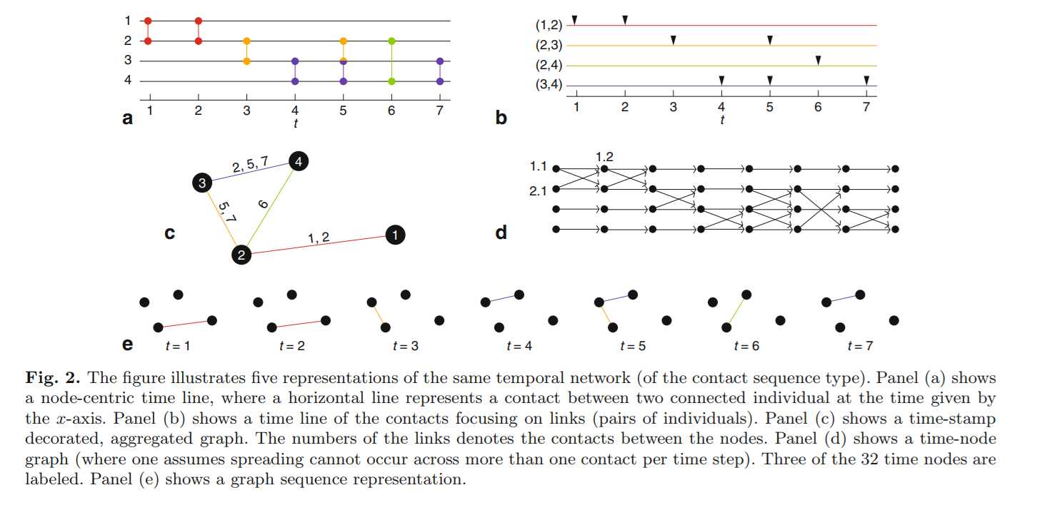
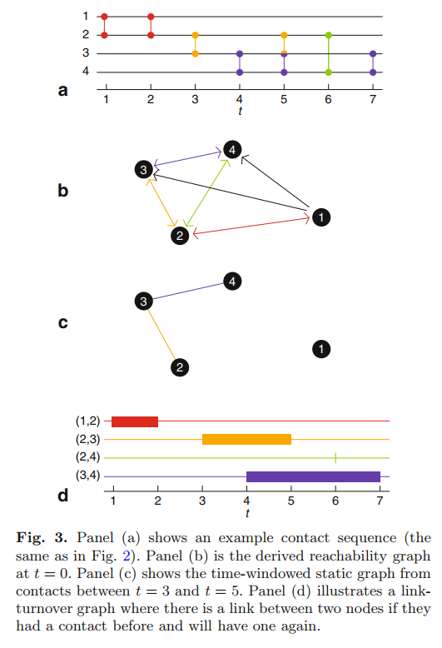
The temporal dimension of networks
Different representations of temporal networks, from: https://link-springer-com/article/10.1140/epjb/e2015-60657-4

Slide 7
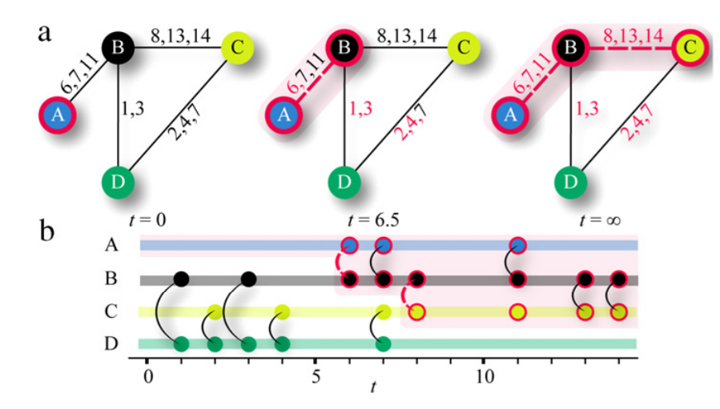
The temporal dimension of networks

Slide 8
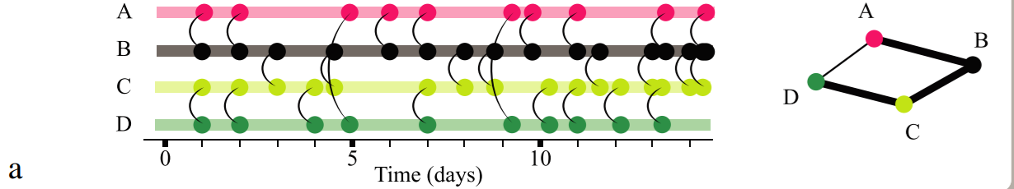
The temporal dimension of networks
When is it required to pay attention to temporal order?
  Interactions need to have temporal structure:
    E.g. Clear ordering
When interactions are frequent and closely spaced:
  They can be modelled by a weighted network agregated across time-periods

Slide 9
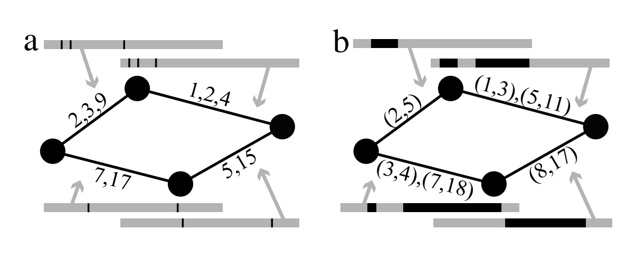
The temporal dimension of networks
Two types of temporal network representation:
  Contact sequences
  Interval graphs
In a contact sequence:
  Edges preserve information about instantaneous communication events between vertices
  Event times are an ordered series of integers
  System fully represented by a set of contact triplets:
    G = (i, j, t) where i, j ∈ V

Slide 10
The temporal dimension of networks
Two types of temporal network representation:
  Contact sequences
  Interval graphs
In a contact sequence:
  Edges preserve information about the time-interval between uninterrupted contacts
  Event times are sets of ordered paired of beginning and and end sequences
  Intervals are non-overlapping within edges but can overlap between edges

Slide 11
Walks, Trails, Paths
A walk is an alternating sequence of vertices and edges {u₁, e₁₂, u₂, e₂₃, u₃....u_{n}} starting with an origin vertex u₁ ending with a destination vertex u_{n} such that:
  Each vertex in the sequence (excluding the origin and destination vertices) is adjacent to the vertex the precedes it and the vertex that follows it
The length of the walk is the number of edges contained in the sequence
  A walk is called a path if all edges and all vertices appear only once in the sequence
Graph-theoretic paths can be used to represent the social network concept of “n-degrees of separation” between people
  In particular, we may be interested in the length of the shortest path (L > 1) linking two people

Slide 12
Walks, Trails, Paths
A walk is an alternating sequence of vertices and edges {u₁, e₁₂, u₂, e₂₃, u₃....u_{n}} starting with an origin vertex u₁ ending with a destination vertex u_{n} such that:
  Each vertex in the sequence (excluding the origin and destination vertices) is adjacent to the vertex the precedes it and the vertex that follows it
The length of the walk is the number of edges contained in the sequence
  A walk is called a path if all edges and all vertices appear only once in the sequence
We may also be interested in the average length of the shortest paths (also called geodesics) linking each pair of vertices in a graph
  When this is smaller than we would expect (e.g. “6”) this quantity can be used to represent the social network concept of a “small world”

Slide 13
The temporal dimension of networks
In temporal networks diffusion can only occur via time-ordered paths
  Like regular paths these are sequences of vertices and edges
  But the edges in the sequence must be in increasing order:
    u₁, e_{i2t(1)}, u_{2,} e_{23t(2)}, u₃, e_{34t(3)}, u₄ is time ordered
    u₁, e_{i2t(3)}, u_{2,} e_{23t(1)}, u₃, e_{34t(2)}, u₄ is not time ordered
If u₁, u₂ interaction (and transmission) occurs after u₂, u₃, then no diffusion from u₁to u₃
  Time respecting paths define which vertices are reachable within a given time interval
  The set of vertices that can be reached by a given vertex u via time respecting paths at time t is u’s influence set
  The set of vertices that can reach u within a given time interval are u’s source set

Slide 14
The temporal dimension of networks
Temporal networks have analogues for shortest paths
  In time ordered paths the length is the difference between the last and first contact time in the path:
    The length of the ACE path is 4 - 3 = 1
    The length of the BDE path is 3 - 2 = 1
    The length of the ABDE path is 3 - 1 = 2
A
t(3)
C
t(4)
E
t(1)
B
D
t(3)
t(2)

Slide 15
The temporal dimension of networks
Temporal networks have analogues for shortest paths
  In time ordered paths the length is the difference between the last and first contact time in the path:
  Two paths can be of the same topological length but of different temporal length
    topological-length(ACE) = topological-length(ABD)
    temporal-length(ACE) < temporal-length(ABD)
A
t(3)
C
t(4)
E
t(1)
B
D
t(3)
t(4)

Slide 16
The temporal dimension of networks
Temporal networks have analogues for shortest paths
  The fastness of a path is equal to the time stamp of its last edge
    The smaller (earlier) the fastest the path is
  Two paths can be of the same temporal length but one can be faster than the other
    The length(ACE) = length(BDE)
    fastness(BDE) > fastness(ACE)
A
t(3)
C
t(4)
E
t(1)
B
D
t(3)
t(2)

Slide 17
The temporal dimension of networks
Temporal networks have analogues for shortest paths
  The fastness of a path is equal to the time stamp of its last edge
    The smaller (earlier) the fastest the path is
  One path can be temporally longer than another and yet be of equal or greater fastness
    The length(ABDE) > length(ACE)
    fastness(ABDE) > fastness(ACE)
A
t(3)
C
t(4)
E
t(1)
B
D
t(3)
t(2)

Slide 18
The temporal dimension of networks
Temporal networks have analogues for shortest paths
  The fastest time-ordered path between two nodes is their latency or temporal distance
  For nodes A and E, this is path ABDE
One may also calculate the average latency between two pairs of nodes
  For nodes A and E, this is: (4 - 3) + (3 - 2) / 2 = 1.5
A
t(3)
C
t(4)
E
t(1)
B
D
t(3)
t(2)

Slide 19
Time-Ordered Networks
Moody example (interval graph representation)
  Ignore times and you have a typical fully connected network graph (there is a possible path between any two vertices)
  Bring in times, and some paths disappear
  Path only exists between two nodes if intervals are time ordered
DA path exists, but not AD path
C
(8, 9)
E
(3, 7)
A
(2, 5)
B
(0, 1)
D
(3, 5)
F

Slide 20
Time-Ordered Networks
Concurrent edges that share a node define reciprocal or two way relations
  A-B concurrent with B-C because intervals overlap
Therefore AC path exists and and so does CA path
C
(8, 9)
E
(3, 7)
A
(2, 5)
B
(0, 1)
D
(3, 5)
F

Slide 21
Time-Ordered Networks
Diffusion paths are sequences of edges in which each new edge follows the past edges in time
  AB, BC, CE
C
(8, 9)
E
(3, 7)
A
(2, 5)
B
(0, 1)
D
(3, 5)
F

Slide 22
Time-Ordered Networks
Diffusion paths are sequences of edges in which each new edge follows the past edges in time
  AB, BC, CE
  DB, BC, CE
C
(8, 9)
E
(3, 7)
A
(2, 5)
B
(0, 1)
D
(3, 5)
F

Slide 23
Path (reachability) Graph
Direct edges in the interval graph get a bi-directional (red) edge in the reachiability graph
  Transmission can go both ways
  E.g. AB, BD, BC, CE, DF
C
E
A
B
D
F

Slide 24
Path (reachability) Graph
Indirect paths in the interval graph get a one-directional (blue) edge in the reachability graph
  E.g. for vertices A and D, only arc DA
C
E
A
B
D
F

Slide 25
Path (reachability) Graph
Indirect paths in the interval graph get a one-directional (blue) arc in the reachiability graph
  Reachability (density of paths):
    Static Network = 1.0
    Temporal Network = 0.6
C
E
A
B
D
F

Slide 26
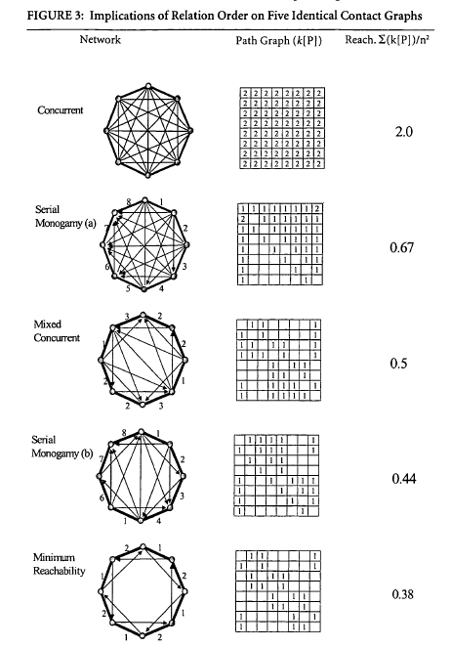
Reachability
8 vertices
heavy lines are ties
timing noted on edges
indirect paths inside circle
Path graph indicates number of temporal paths between two vertices
  Note asymmetry
  Note non-transitivity
  Note difference between 2 serial monogamy graph

Slide 27
Reachability
8 vertices
heavy lines are ties
timing noted on edges
indirect paths inside circle
Path graph indicates number of temporal paths between two vertices
  1 change in relationship timing leads to big change in reachability
  Implications for all measures of centrality that involve paths (e.g. betweeness, closeness)
  and also brokerage

Slide 28
Diffusion Revisited
Possibility of diffusion: time-ordered path
Probability of diffusion:
  pairwise transmission probability (q)
  if q < 1 then diffusion probability = f(number of paths, length of paths)
Diffusion is an emergent property
  depends on one's partner's future partner's

Slide 29
General representation of temporal networks
As we have seen a time evolving networked system has three components:
  A set of contacts (time-stamped edges) C, a set of nodes V, and an interval within which the system is observed {0, T}
  A contact between two vertices is thus a quadruplet:
    C = {i, j, t, δt}
      Where δt is the contact duration
      In special case of in which δt is considered instantanoeus then contact reduces to a triplet {i, j, t}

Slide 30
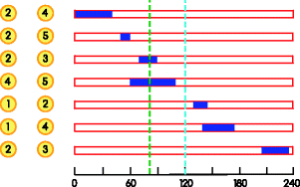

General representation of temporal networks
Representing temporal graphs as static aggregated graphs can be a problem:
  Loss of information
  Multiple but incompatible representations of the same temporal system
  Unclear how to choose between different static representations
  May be appropriate if interested in topological characteristics only

Slide 31
General representation of temporal networks
One way to incorporate time is to create a separate graph for multiple time instant t
  More appropriately, we can define a time-window [t, t + 𝛥t] and place an edge between all pairs of vertices for which we observe a contact during that window

Slide 32
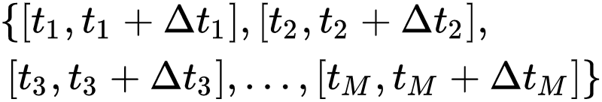
General representation of temporal networks
A sequence of successive non-overlapping time-windows yields a time-varying graph:
This is a sequence of M graphs {G₁, G₂, …, G_{M}} defined over V vertices
  Each graph G_{m} defines the state of the network in the time window:

Slide 33
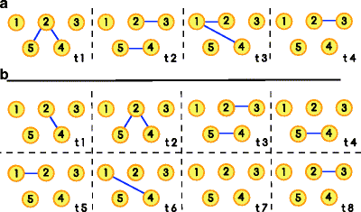
General representation of temporal networks
We can choose the time window to represent different snapshots of the same system at different time scales
  The longer the time scale the greater the chances of observing an edge between two nodes
  Smaller time scales more likely to yield low density/empty graphs

Slide 34
General representation of temporal networks
We have seen that nodes in temporal networks are connected by temporally ordered paths:
  Two nodes are temporally connected if there exists a temporally ordered path between them during a time window
    Not a symmetric relation
  Two nodes i, j, have strong temporal connectivity if i is temporally connected to j and j is temporally connected to i
    Strong temporal connectedness is not necessarily a transitive relation
  Two nodes i, j, have weak temporal connectivity if they are connected in the underlying temporal graph that ignores link directionality but retains time ordering
    Connectivity is retained across time windows of increasing size

Slide 35
General representation of temporal networks
We have seen that nodes in temporal networks are connected by temporally ordered paths:
  The temporal out(in)-component of a node i, is the set of nodes that can be reached from (can reach) i
  The strong temporal out(in)-component of a node i, is the set of nodes that can be reached from (can reach) i and that can also reach i
The size of temporal out and in components are sensitive to time windows
  The exhibit heterogeneity over time within nodes and heterogeneity within time across nodes
  They are generally smaller than the giant component of the time-aggregated graph

Slide 36
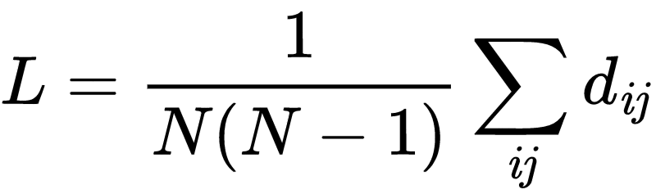
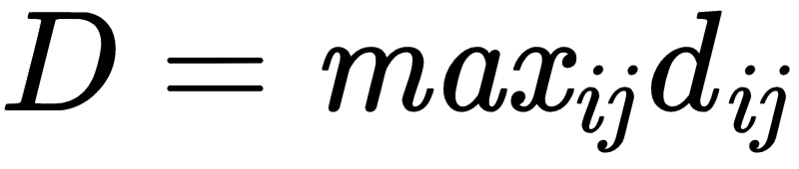
General representation of temporal networks
As we have seen the temporal length of a given time-ordered path does not have to correspond to it’s graph-theoretic length
  In a temporal graph therefore a natural extension of the average geodesic distance is the characteristic temporal path length:
Where d_{ij} is the shortest temporal length between nodes i and j within time window [t, t + 𝛥t]
  The temporal diameter of the graph can also be defined accordingly:

Slide 37
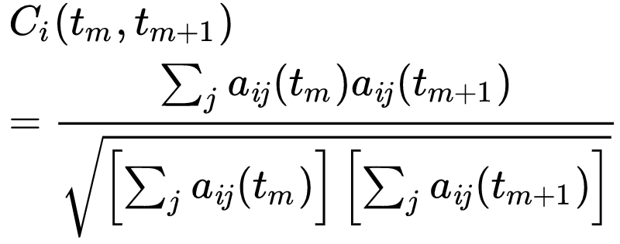
General representation of temporal networks
Temporal graphs allow for the calculation of ego-level temporal metrics
We may be interested in the persistence of ego’s links to its neighbors over time
  If we consider a given node i, observed over successive time-windows (snapshots) t_{m} and t_{m+1}
  Then the topological overlap over successive temporal neighborhoods can be defined as:

Slide 38
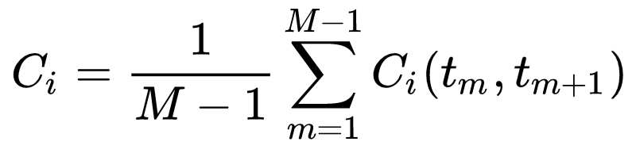
General representation of temporal networks
Temporal graphs allow for the calculation of ego-level temporal metrics
We may be interested in the persistence of ego’s links to its neighbors over time
  The average topological overlap for node i is that same quantity averaged over all available snapshots:
This can be thought of as a temporal extension of the clustering coefficient for static graphs

Slide 39
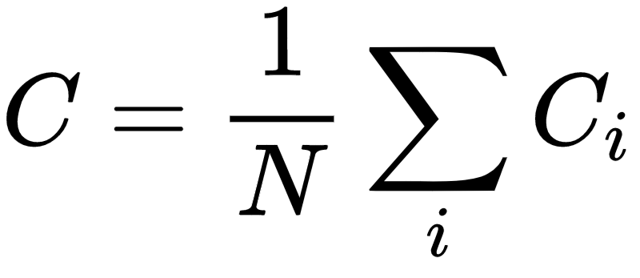
General representation of temporal networks
Temporal graphs allow for the calculation of ego-level temporal metrics
We may be interested in the persistence of ego’s links to its neighbors over time
The average (across vertices) of the average topological overlap (within vertices across time) then gives us the graph index called the temporal correlation coefficient:
This is the average probability that an edge will persist across successive snapshots

Slide 40
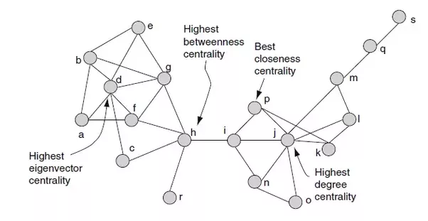
A typology of centrality measures
Centrality measures appear to cluster around some key dimensions
A vertex is central insofar as a lot of walks of a certain type either:
  Feature that node as their origin or endpoint
    These are "radial" measures (e.g. degree)
  Contain that node in the walk sequence
    These are "medial" measures (e.g. betweenness)

Slide 41
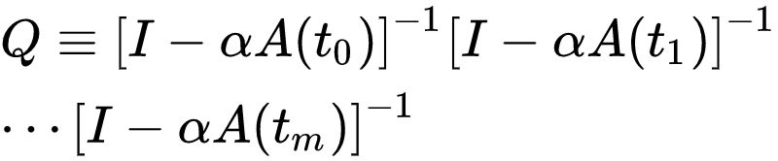
The temporal dimension of networks
Temporal Medial Centralities for Vertices (e.g. Closeness, Betweenness):
  Can be redefined so that they count over temporal shortest paths
  One thing to worry about is what to do with unreachable pairs of vertices within a given time-window
    For closeness, graph is required to be connected for the calculation window
Temporal Radial Centralities
  Can be computed by calculating the product of the snapshot specific radial centralities across different snapshots:

Slide 42
The temporal dimension of networks
Temporal Medial Centralities for Vertices (e.g. Closeness, Betweenness):
  Can be redefined so that they count over temporal shortest paths
  One thing to worry about is what to do with unreachable pairs of vertices within a given time-window
    For closeness, graph is required to be connected for the calculation window
Temporal Radial Centralities
  This communicability matrix give us a sense of the extent to which each node can reach every other node by paths of arbitrary length across all temporal snapshots

Slide 43
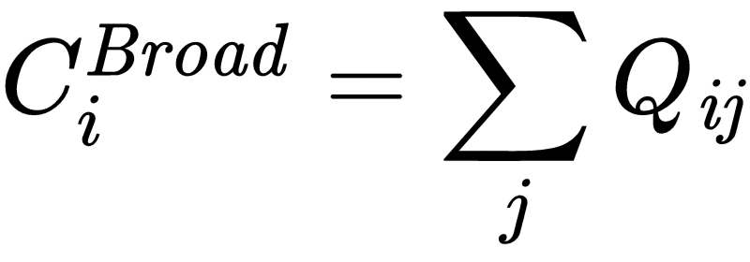
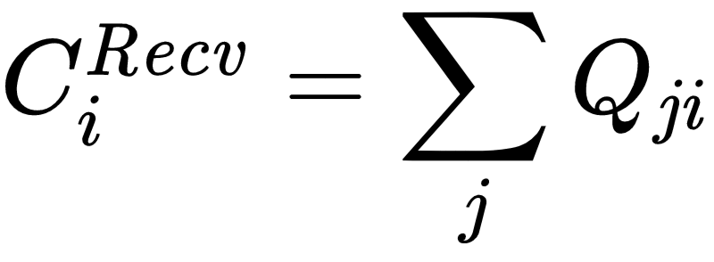
The temporal dimension of networks
Temporal Medial Centralities for Vertices (e.g. Closeness, Betweenness):
  Can be redefined so that they count over temporal shortest paths
  One thing to worry about is what to do with unreachable pairs of vertices within a given time-window
    For closeness, graph is required to be connected for the calculation window
Temporal Radial Centralities
  Sum of the rows of the Q matrix is the temporal broadcast centrality of node i
  Sum of the columns of the Q matrix gives us the temporal reachability of node i

Slide 44
The temporal dimension of networks
Temporal extensions of:
  Graphlets, motifs
  Community structure, groups
  Position and equivalence
  Small world phenomena

